Slide 1
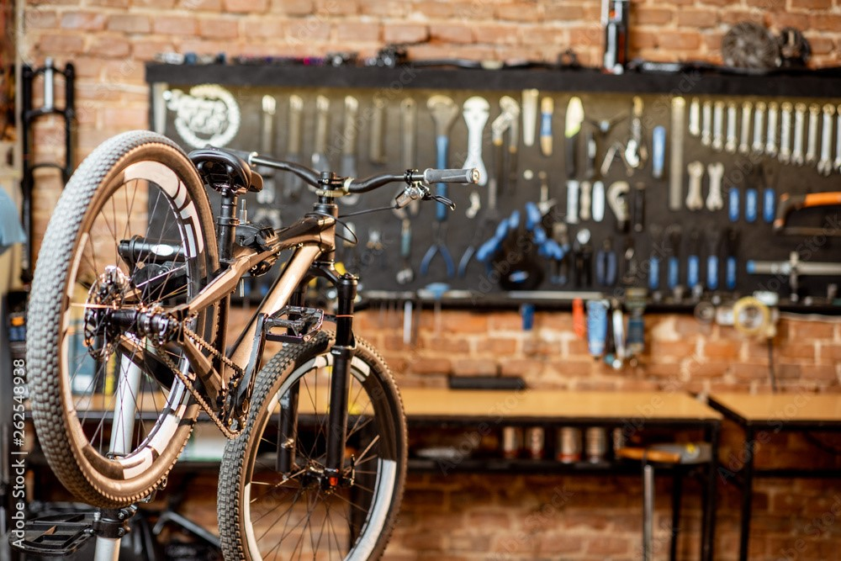
The AdventureWorks
Cycles Company​ ​ A Comprehensive Analysis
of Revenue Drivers: ​
Regional Performance,
Employee Behaviour, ​
Store Characteristics, and ​ Sales Trends for Bikes​

Slide 2

Content
Project overview
Generate Business Insights
(1) Regional sales in the best performing country
(2) Relationship between annual leave taken and bonus
(3) Relationship between country and revenue
(4) Relationship between sick leave and job title
(5) Relationship between store trading duration and revenue
(6) Relationship between the size of the stores, number of
employees and revenue
Additional Insights
Conclusion

Slide 4
Project overview
Project Puropose:
Analyze the AdventureWorks dataset to generate business insights
Answer key questions relevant to organizational performance
Provide actionable recommendations for further analysis
Libraries used:
Matplotlib
Pandas
Seaborn
Statsmodel
Pyodbc
SQLAlchemy2
Project Members:
Ali M:
Abdi S
Ailin G
Michelle W
Muhammod S Sharifa S

Slide 5
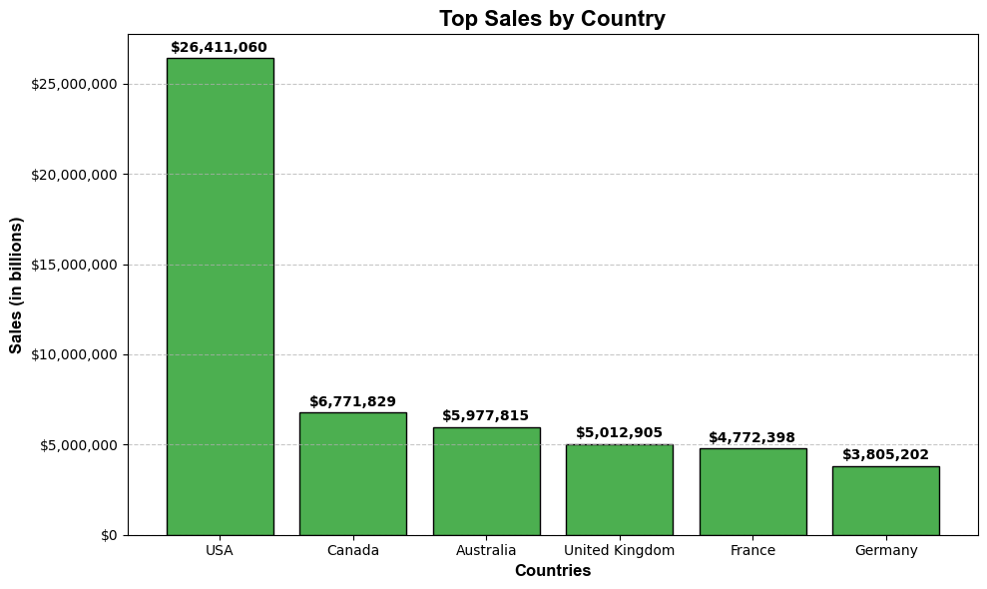
What are the sales in the best performing country?
The chart shows total sales by country, with the USA leading at $26,411,060, followed by Canada, Australia, and Uk

Slide 6
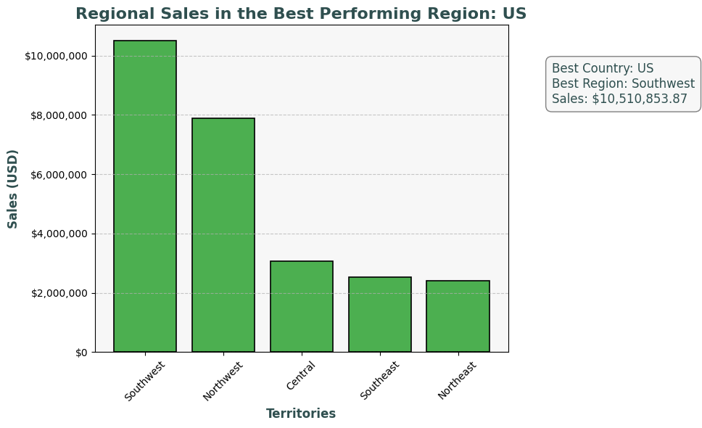
What are the regional sales in the best performing country?
Notes:
Southwest has california, they know how to party and waste money
Hi randell
Northwest has Washington, where the company is based

Slide 7
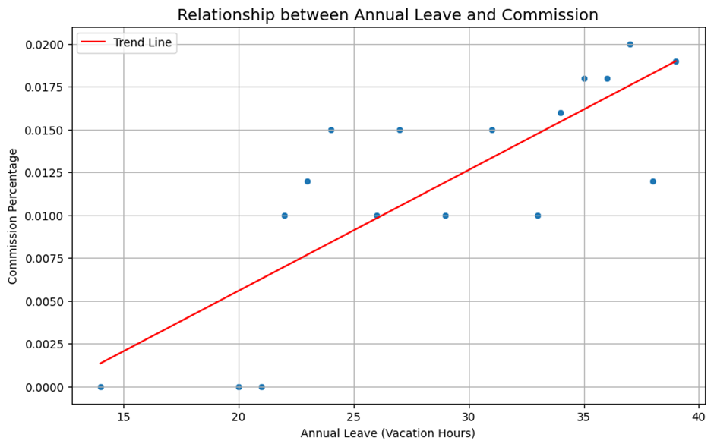
What is the relationship between annual leave taken and bonus?
Examines the relationship between vacation hours and commission percentage
Commission percentage: Earnings based on sales
Vacation hours: Time off taken by employees

Slide 8
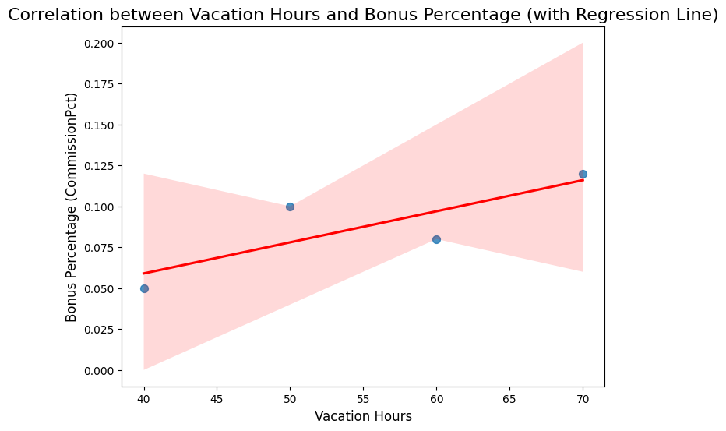
What is the relationship between annual leave taken and bonus?
Correlation Between Annual Leave (Vacation Hours) and Bonus:
There is a moderate positive correlation (0.82) between vacation hours and bonus percentages. This suggests that employees with more vacation hours tend to receive higher bonuses.
Relationship is not statistically significant
Slight positive effect: Each additional vacation hour may slightly increase commission, but the effect is minimal

Slide 9
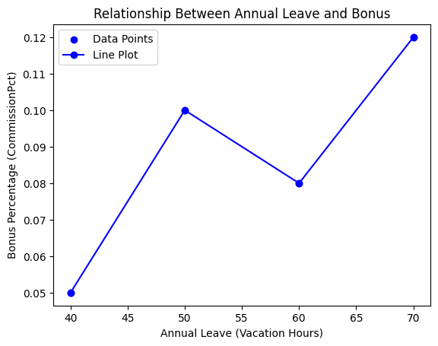
What is the relationship between annual leave taken and bonus?
The company’s leave and bonus policies show a relationship between higher vacation leave and increased bonuses.
Further analysis on organizational levels and employee tenure could provide more specific insights.

Slide 10
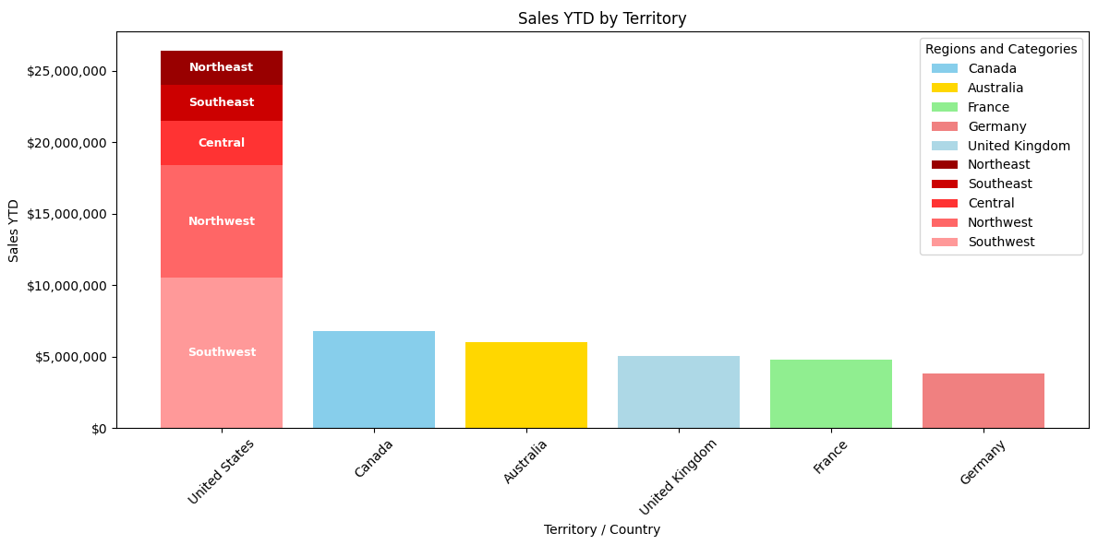
What is the relationship between Country and Revenue?
The US has the highest number of sales, with the Southwest region alone accounting for more sales than the other countries
European sales are the weakest

Slide 11
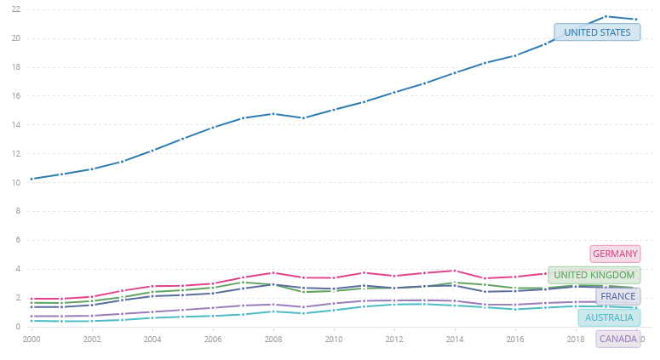
What is the relationship between Country and Revenue?
The United States had the highest GDP of all countries in the database which matches their sales performance relative to the other nations
Despite Canada having the second lowest GDP of the group in 2014 (1.81 trillion) they still accounted for the second highest sales
This points further to issues with overseas sales performances (a stronger GDP should imply more readiness to purchase the product)
GDP of the United States, Canada, United Kingdom, Germany, France and Australia between 2000 and 2020
https://data.worldbank.org/indicator/NY.GDP.MKTP.CD?end=2020&locations=US-GB-FR-DE-AU-CA&start=2000&view=chart

Slide 12
What is the relationship between Country and Revenue?
Region | Tariff on Bicycles (HS Code: 8712) | Tariff on Bicycle Parts (HS Code: 8714) | Trade Agreement with USA
European Union | ~14% (MFN rate) | ~4-6% (MFN rate) | None
Canada | 0% (NAFTA-qualified products) | 0% (NAFTA-qualified products) | NAFTA
 | ~6.5% (non-NAFTA products) | ~6.5% (non-NAFTA products)
Australia | 5% (MFN rate) | 0-5% (MFN rate) | AUSFTA (limited impact)
Europe has the highest tariffs as they did not have a special trade agreement with the US in 2014
Canada has a special trade agreement with the US that allows AdventureWorks to export their goods tariff free
Australia had a trade agreement with US in this period, but it would not have covered this industry, so standard tariffs would have been applied
European Union TARIC Database: https://ec.europa.eu/taxation_customs/dds2/taric/
Canada Border Services Agency Tariff Information: https://www.cbsa-asfc.gc.ca/trade-commerce/tariff-tarif/menu-eng.html
Australian Border Force Tariff Classification: https://www.abf.gov.au/tariff-classification
World Trade Organization – Tariff Analysis Online: https://www.wto.org/english/res_e/statis_e/statis_e.htm
U.S. Office of Trade Representative (NAFTA Resources): https://ustr.gov/
Export Assistance – Trade.gov (formerly Export.gov): https://www.trade.gov/

Slide 13
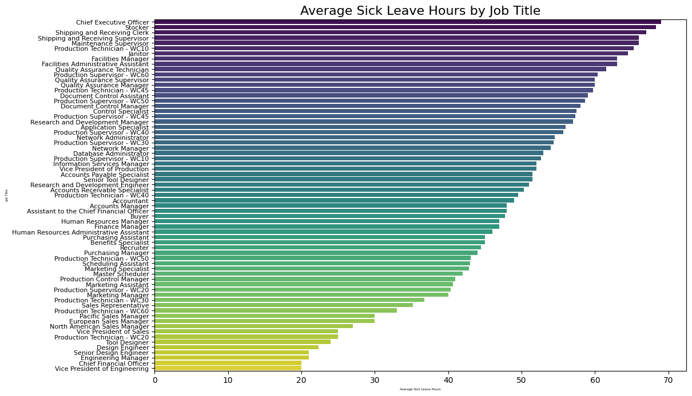
What is the relationship between sick leave and Job Title (PersonType)?
Job Title
Average sick leave hours
Notes:
Limitation of model: the average is not as accurate because there are a different number of workers per job title. For example, there is only one CEO, so the average is however many hours the CEO took. There are multiple stockers, so there may have been one stocker who took a large number of sick leave hours which raised the average or similar

Slide 14
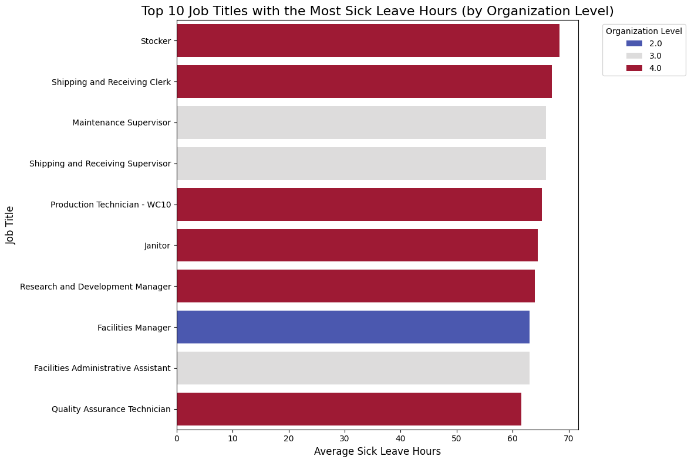
What is the relationship between sick leave and Job Title (PersonType)?
The organisation level with the highest number of sick leave hours is level 4 (the lowest level)
The second level with the greatest number of sick leave hours is level 3, then level 2

Slide 15
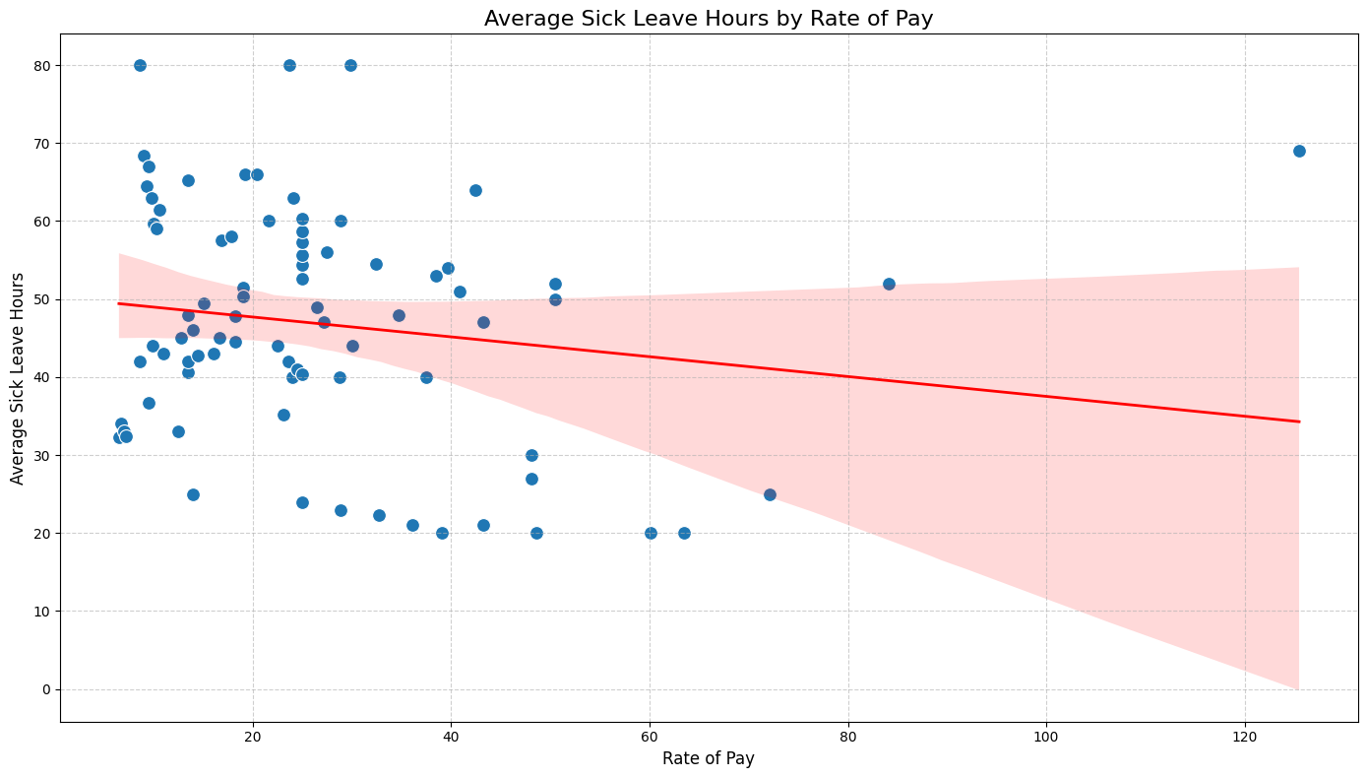
What is the relationship between sick leave and Job Title (PersonType)?
Slight negative correlation, but it is not significant enough to draw conclusions
The correlation coefficient between the two values is -0.00341312
Does not correspond with what we saw about the organisation level, as we saw that those who are on a lower level tend to take more sick leave

Slide 16
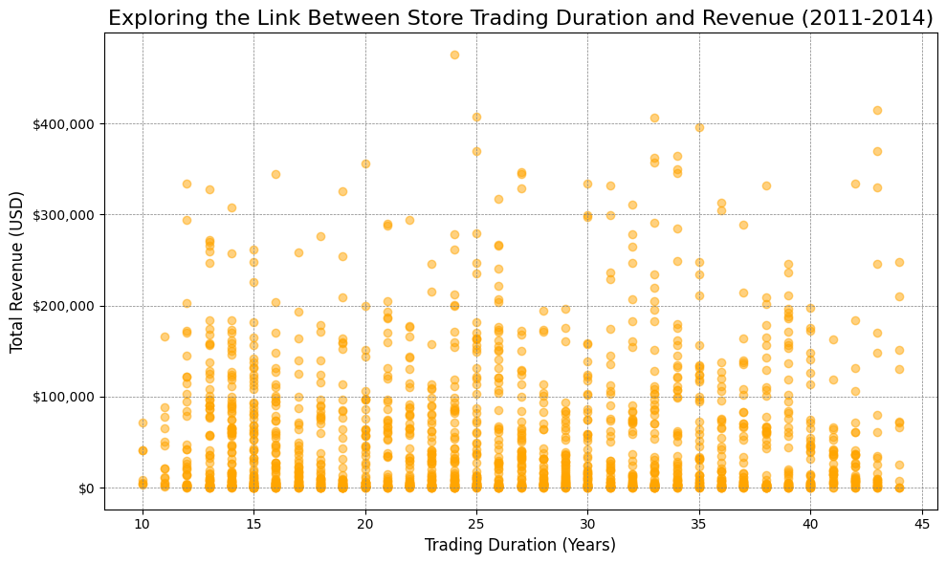
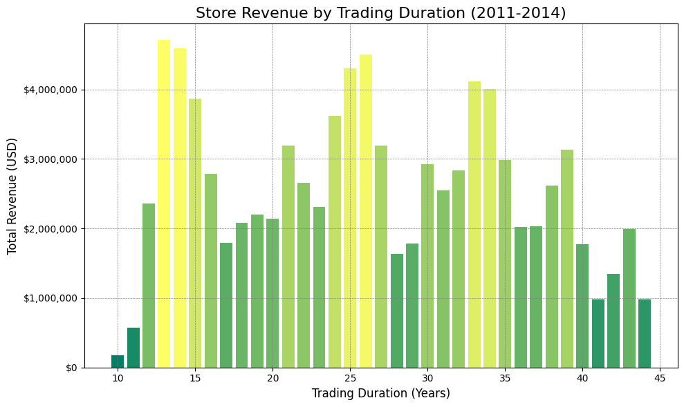

What is the relationship between store trading duration and revenue?

Slide 17
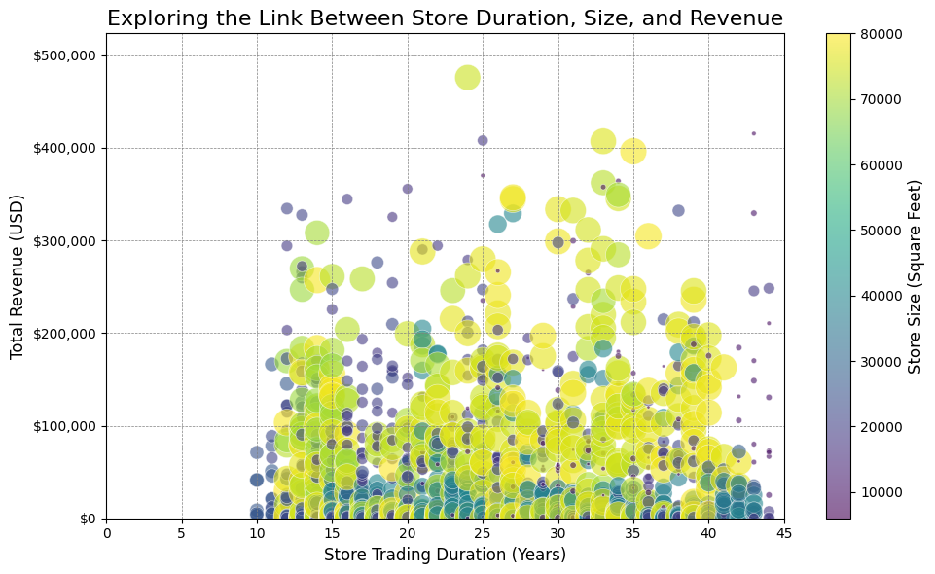
What is the relationship between store trading duration and revenue?
Weak/Inconsistent Correlation
NO trend or clear pattern
Possible Reasons for this weak or fluctuating relationship
Location
Seasonality
Marketing efforts
Product offerings

Slide 18
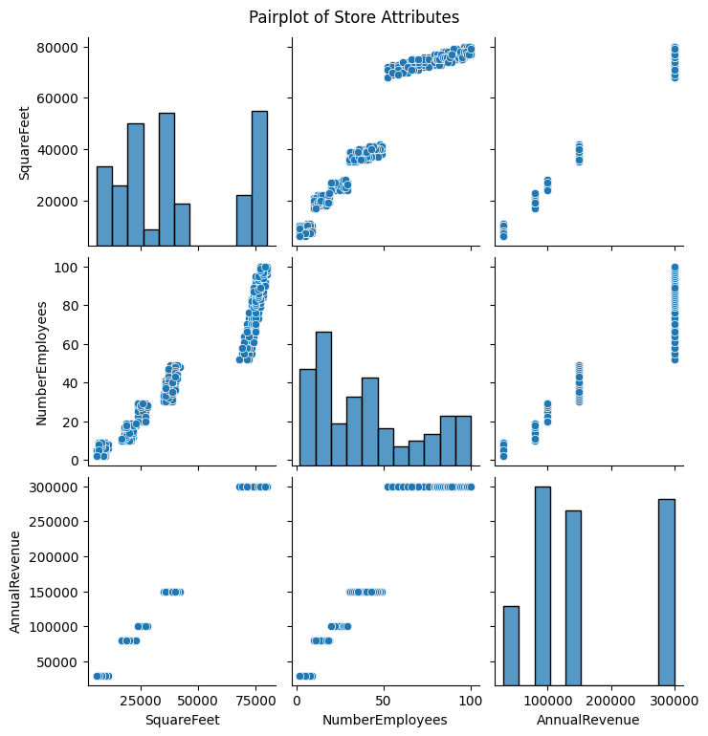
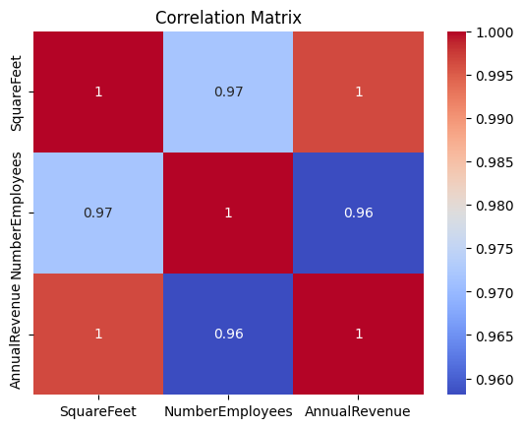
What is the relationship between the size of the stores, number of employees and revenue?

Slide 19
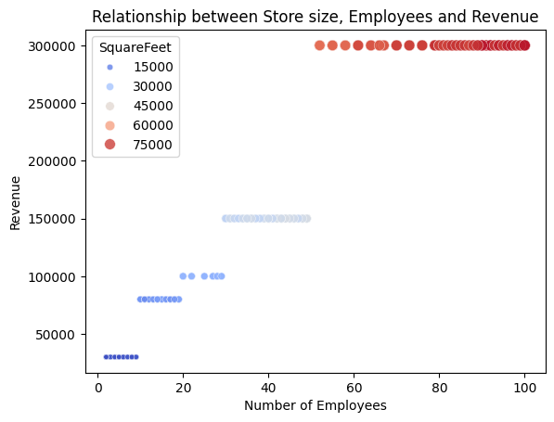
What is the relationship between the size of the stores, number of employees and revenue?
Key Findings:
Number of Employees vs Store Size :
Larger stores generally require more employees
Number of Employees vs Revenue:
(1) Comparison between clusters:
Larger stores with more employees tend to
generate higher revenue
(2) Comparison within each cluster:
The number of employees will NOT affect revenue.
Number of Employees vs Store Size vs Revenue:
Larger stores with more employees will generate more
revenue

Slide 20

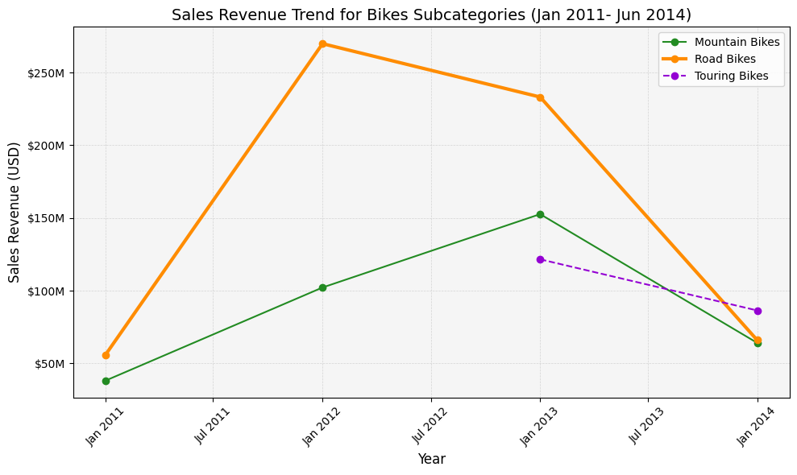
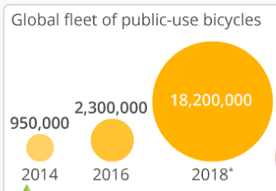
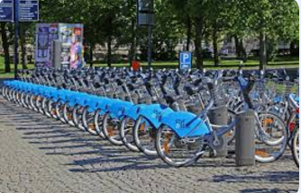
Additional INSIGHT
Sales Revenue Increase
External Factors
Cycling at the 2012 Summer Olympics
$270M
$233M
382% up
4.82 times
Drop 72%
Sales Revenue Decrease
External Factors
Bikes Share Programme
$153M
Drop 58%
$102M
$122M
$86M
$66M
168% up
2.68 times
$64M

Slide 21
Conclusion
The southwest region of the US has the most sales.
A correlation was found between annual leave and bonus, this could offer insights for employee benefit decisions.
The US is the strongest performing market, but sales are being bottlenecked by overseas tariffs, especially in Europe.
The analysis found no conclusive evidence of a significant relationship between job title and sick leave hours.
No relation between sales revenue and store duration
Larger stores typically require a bigger workforce and generate higher revenue.
Sales trend of bikes is strongly influence by the external factors (Olympic events)

Slide 22
THANK YOU

